Slide 1
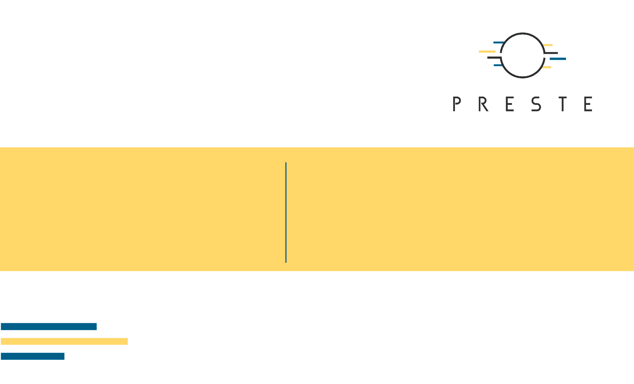
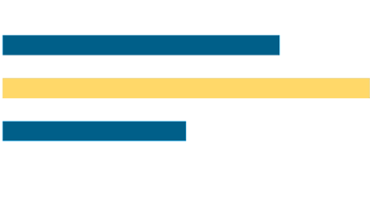
Cheminformatics and Molecular Descriptors
From SMILES and molecular graphs to dynamic QSPR and polymers

Slide 2

What's for today
• Understand where common QSAR descriptors actually come from.
• Distinguish 1D/2D, 3D, fingerprint and learned representations.
• Connect molecular conformations and MD trajectories to dynamic descriptors.
• Understand why polymers require richer representations such as BigSMILES.
• Build a defensible cheminformatics → QSAR/QSPR workflow.

Slide 3

1. From chemical structure to?
Before choosing a model, decide what information the model is allowed to see.

Slide 4
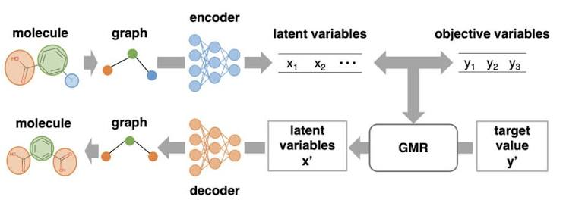
The QSAR/QSPR abstraction

Slide 5
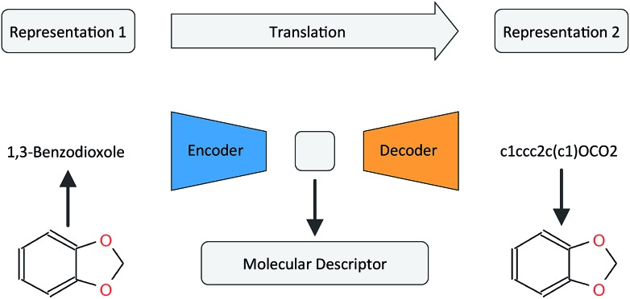
Representation ≠ descriptor
• SMILES string
• Molecular graph
• 3D coordinates / conformer
• MD trajectory
• BigSMILES / polymer ensemble description
• MolWt = 180.16
• TPSA = 63.6 Å²
• Morgan fingerprint bit-vector
• Radius of gyration = 0.42 nm
• Mean + variance across a trajectory

Slide 6
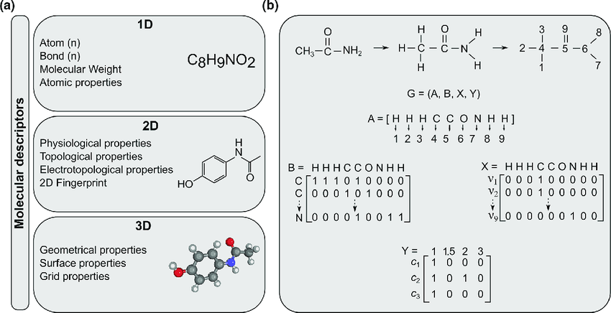
Descriptor dimensionality: what information is used?

Slide 7
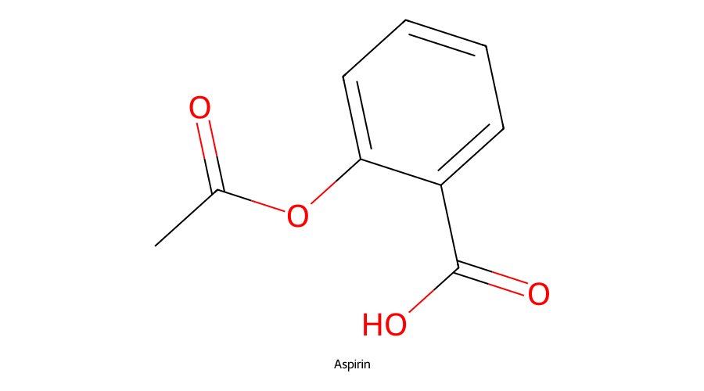
Constitutional descriptors: chemistry by counting
• Atomic composition → element counts
• Molecular weight → sum of atomic masses
• H-bond donors / acceptors → rule-based atom patterns
• Ring counts → graph cycle information
• Rotatable bonds → bond-pattern rules

Slide 8
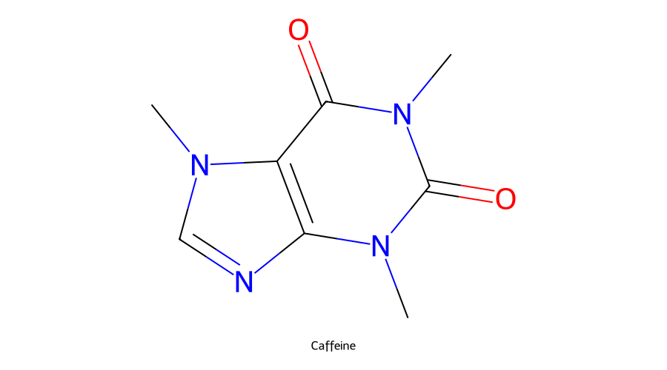
2D descriptors operate on the molecular graph
Graph ingredients
• Vertices: atoms with element / valence / charge labels
• Edges: bonds and bond order
• Shortest-path distance d(i,j)
• Atom degree δᵢ
• Cycles, branching and connectivity patterns
2D descriptors can encode substantial structural information without ever constructing a 3D conformer.

Slide 9
Path-based descriptors: Wiener index
W = ½ Σᵢ Σⱼ d(i,j)
C
C
C
C
• d(i,j) is the shortest-path distance in the molecular graph.
• W increases with graph size and depends strongly on branching.
• No atomic coordinates are required.
linear chain
C
C
C
C
branched graph → different distance pattern

Slide 10
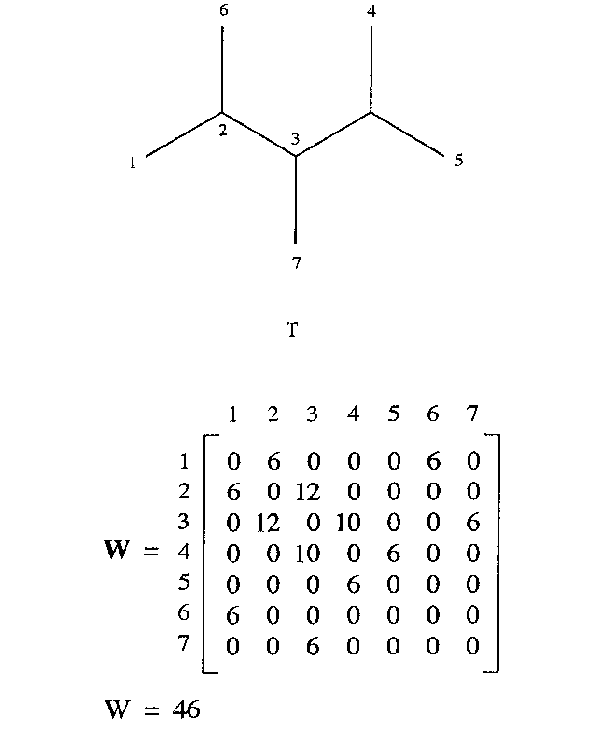
Connectivity indices compress graph topology
Other graph-derived ideas
• Wiener index: sum of shortest-path distances
• Kier–Hall indices
• Topological charge indices
• E-state descriptors
• Graph autocorrelations

Slide 11
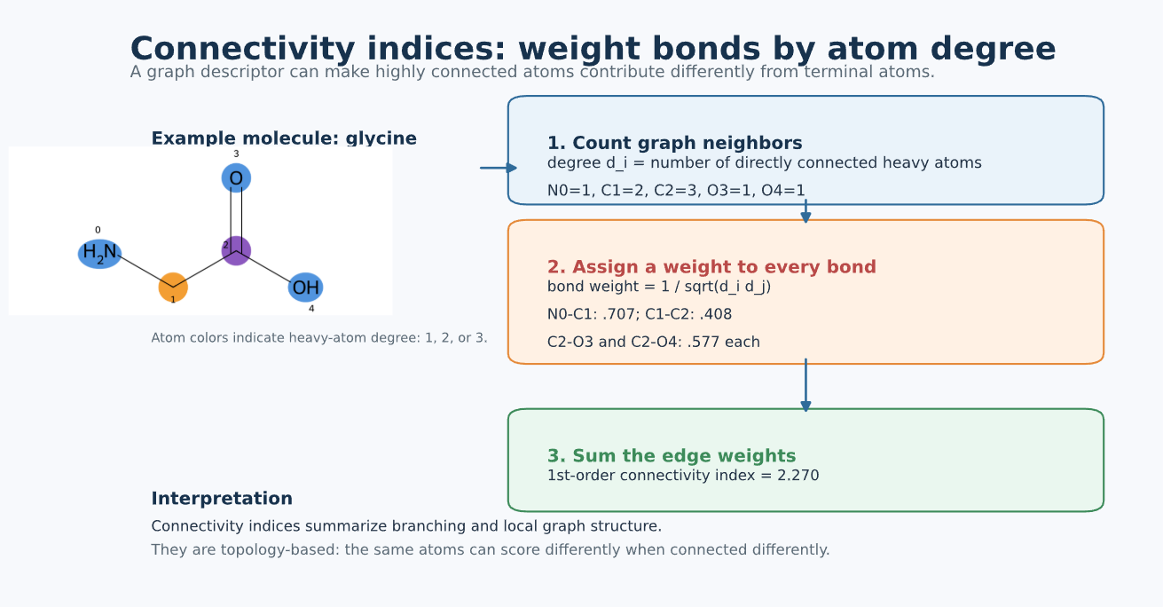
Connectivity indices: weight bonds by atom degree

Slide 12
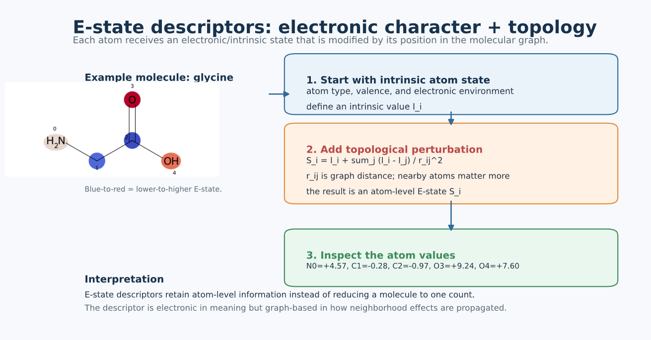
E-state descriptors: electronic character + topology

Slide 13
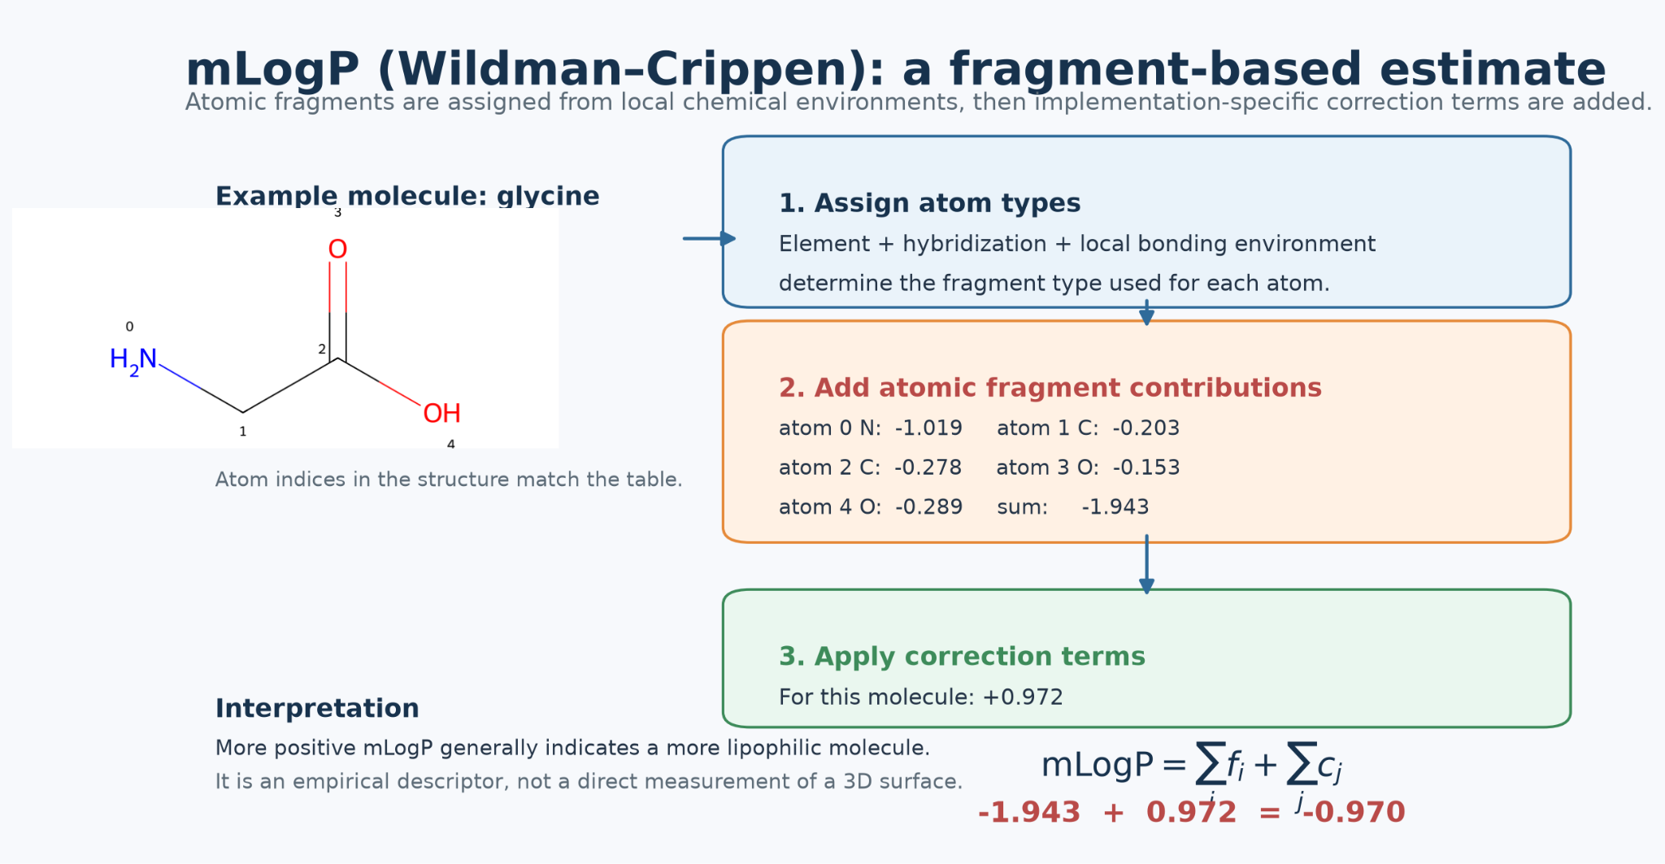
Some “molecular properties” are themselves calculated models

Slide 14
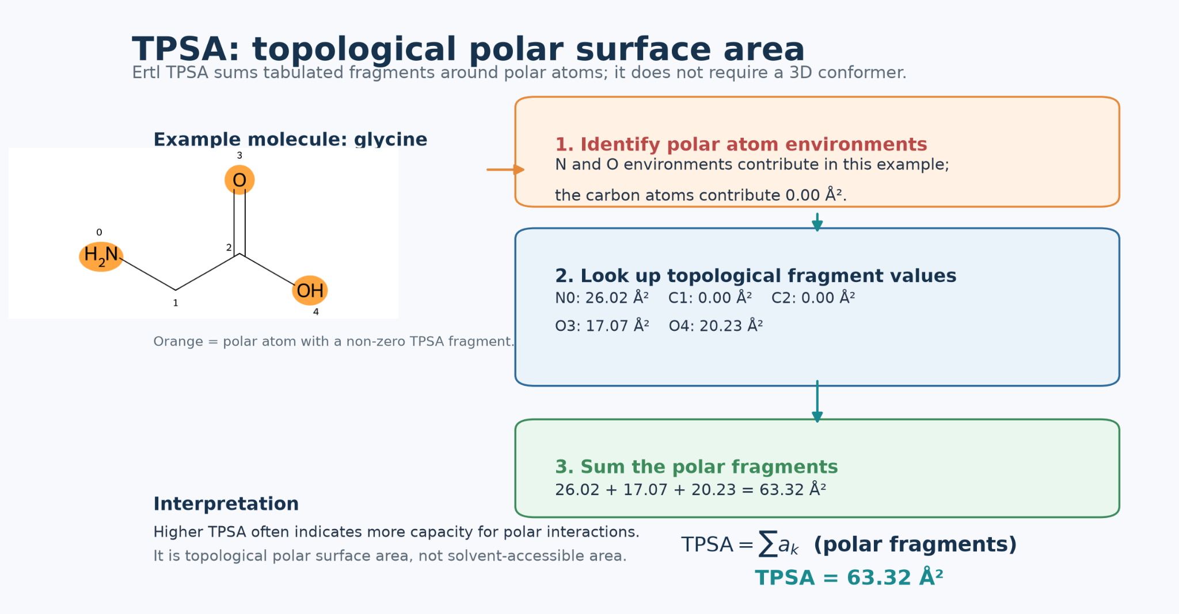
Some “molecular properties” are themselves calculated models

Slide 15
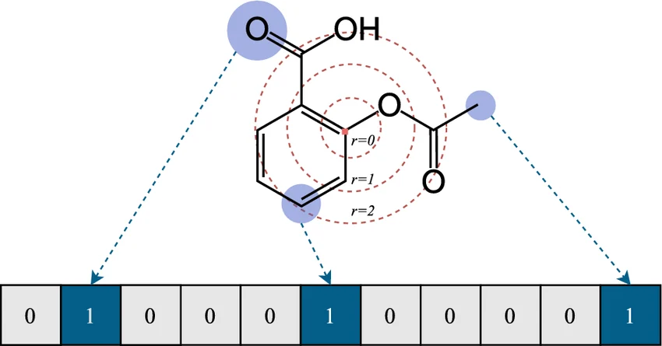
Fingerprints: structural patterns as a high-dimensional vector
Bit vectors encoding substructures
Idea: presence/absence of patterns
Circular(works in radii)
Path-based
Morgan / ECFP
MACCS keys
Topological fingerprints
Atom-pair / torsion fingerprints

Slide 16
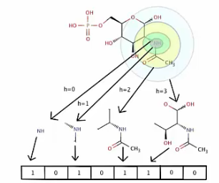
Morgan / ECFP: encode local atom neighborhoods
• Initialize atoms from local properties.
• Iteratively update identifiers using neighboring atoms.
• Radius controls how far from each atom we look.
• Hash identifiers into a fixed-length vector.
• Collisions can occur when different features map to the same bit.

Slide 17
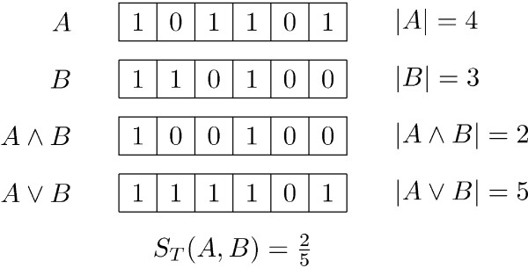
Fingerprints: Tanimoto similarity
Worked example
A has 4 ON bits, B has 3, and 2 are shared.
T = 2 / (3 + 4 − 2) = 2/5

Slide 18
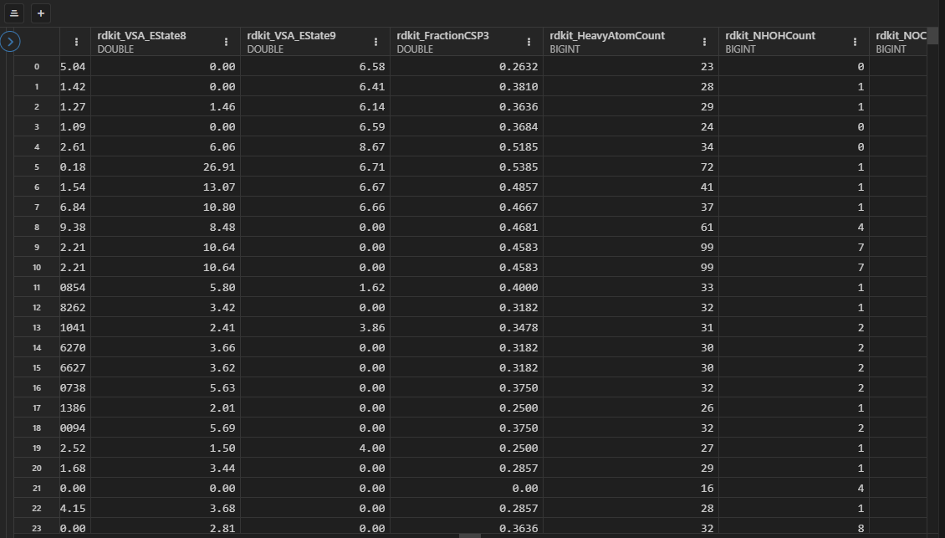
QSAR matrix
Each molecule becomes one fixed-length feature vector.
X ∈ ℝⁿˣᵖ
y ∈ ℝⁿ
Rows = molecules
Columns = descriptors
Target = measured property/activity

Slide 19
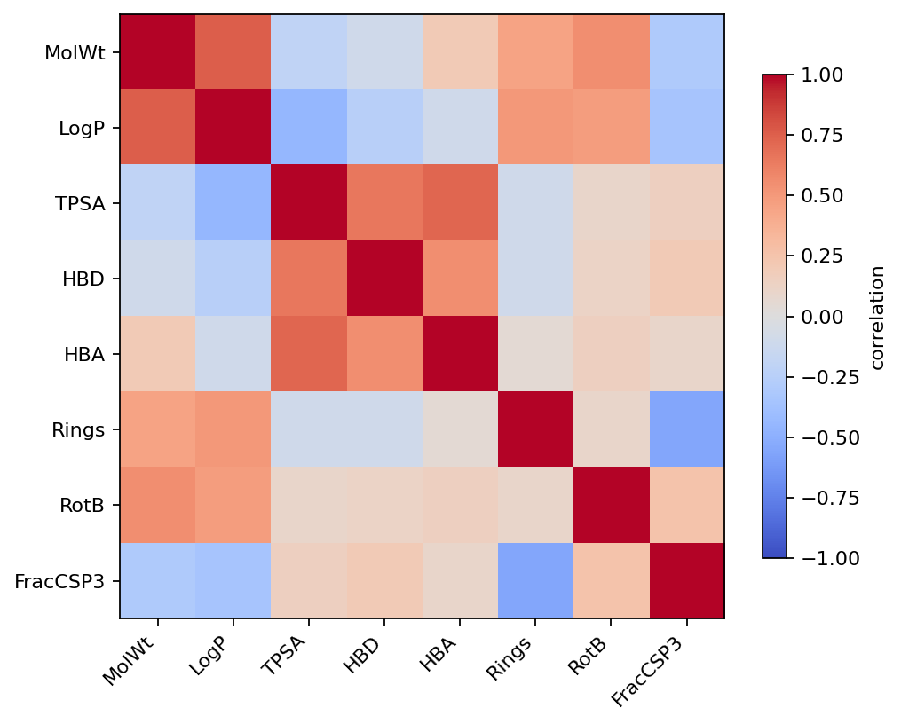
Descriptor redundancy
• MolWt, atom counts and volume-like descriptors may be strongly correlated.
• Hundreds of 2D descriptors can contain duplicate information.
• Feature selection reduces noise and computational cost.
• But aggressive filtering can remove nonlinear or interaction information.

Slide 20

2. From 2D structure to 3D molecular shape
Coordinates -> Geometry -> 3d descriptors -> ???? -> profit

Slide 21
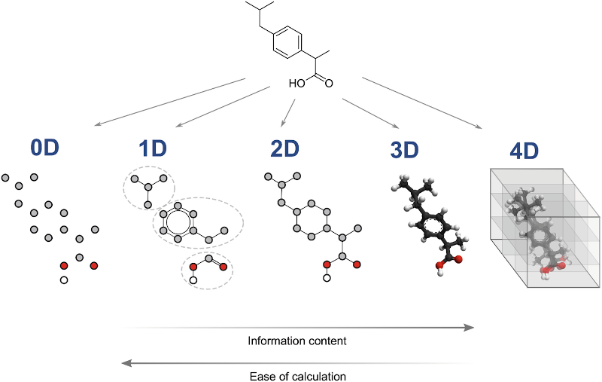
3D descriptors use atomic coordinates
• Molecular volume and surface descriptors
• Moments of inertia
• Radius of gyration
• Shape / eccentricity / asphericity
• Interatomic distance distributions
• 3D autocorrelations

Slide 22
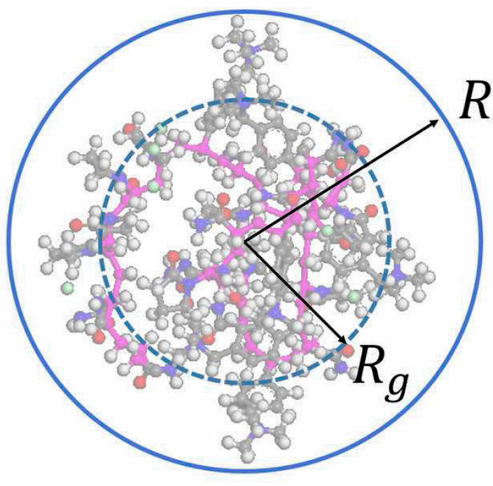
3D descriptors: Radius of gyration
R_g = √[ Σᵢ mᵢ ||rᵢ − r_CM||² / Σᵢ mᵢ ]
Mass-weighted spread of atoms around the molecular center of mass.

Slide 23
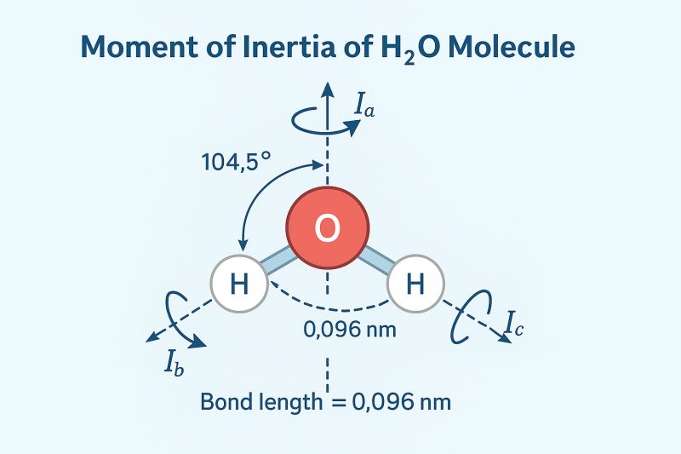
Moments of inertia describe molecular shape anisotropy
• Diagonalize I → principal moments I₁, I₂, I₃.
• Relative values distinguish rod-like, disk-like and spherical shapes.
• Derived shape descriptors include eccentricity and asphericity.

Slide 24
3D descriptor families summarize geometry in different ways
RDF
WHIM
GETAWAY
distance distributions
weighted covariance / shape
geometry + topology
3D-MoRSE
CPSA
scattering-inspired transforms
charge + surface geometry

Slide 25
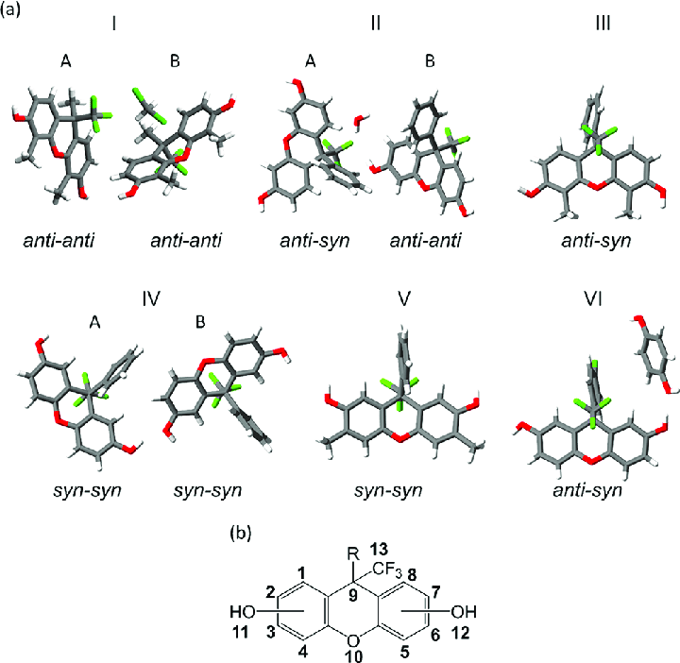
Many conformations per molecule
• Rotatable bonds create many local minima on the conformational energy landscape.
• 3D descriptors are functions of coordinates, so their values can change between conformers.
• A single arbitrary conformer may therefore be a poor molecular representation.
• Typical workflow: generate → optimize → filter by energy/RMSD → summarize.

Slide 26
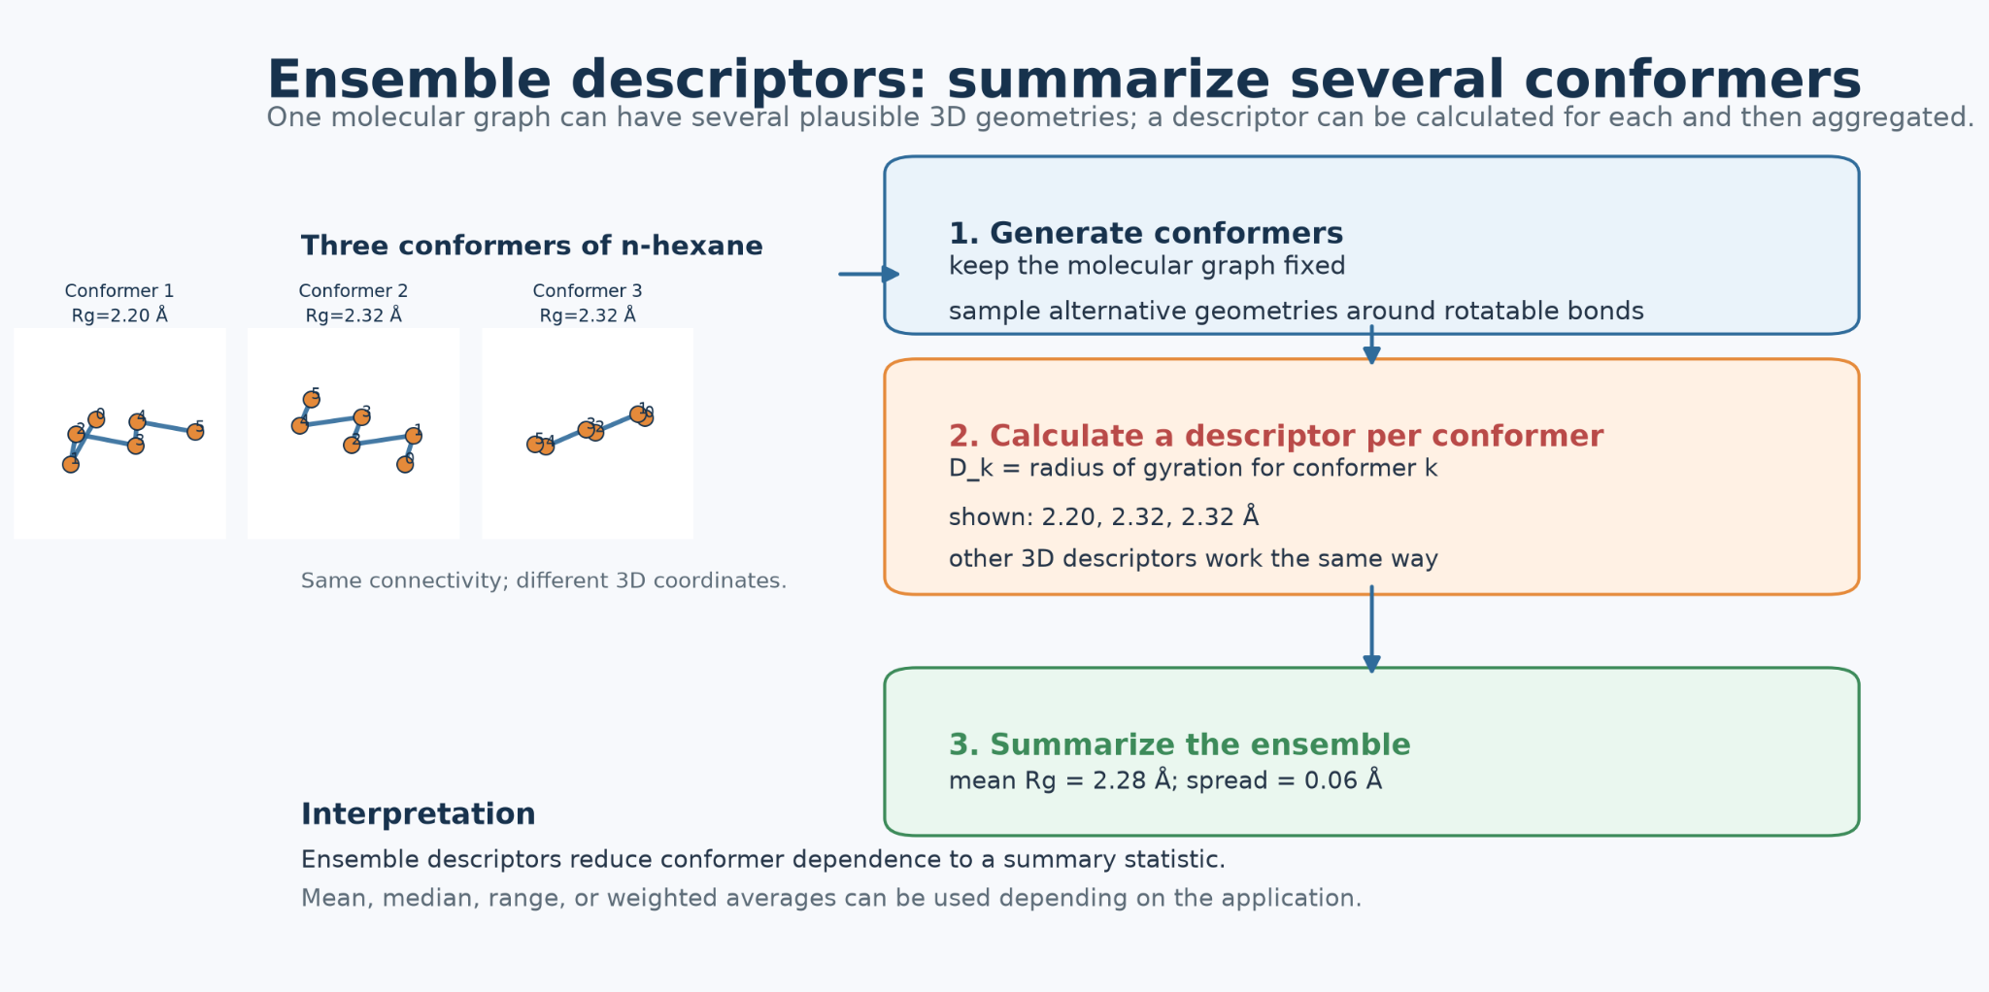
Ensemble descriptors: summarize several conformers

Slide 27
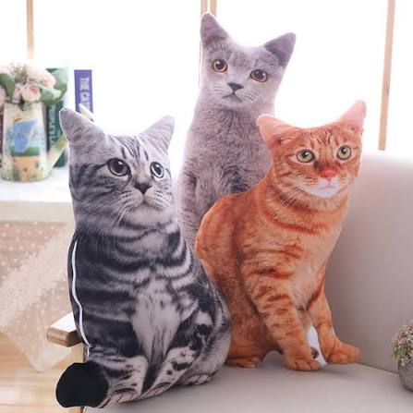
3. Dynamic descriptors and molecular dynamics
The same but overtime

Slide 28

An MD trajectory is a time series of molecular geometries

Slide 29
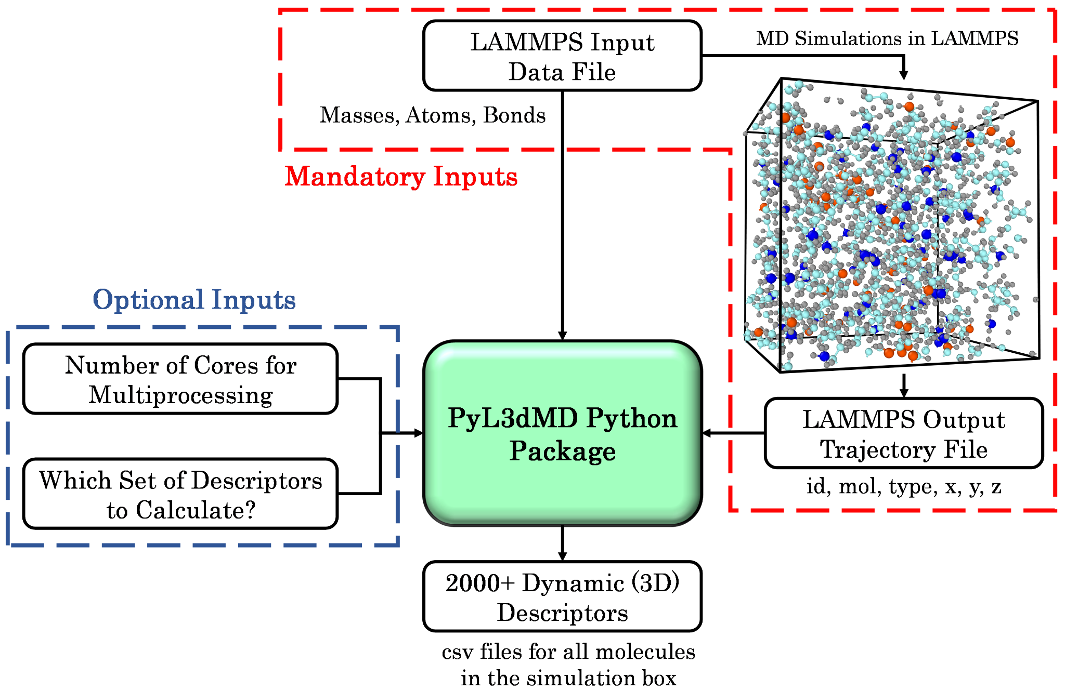
PyL3dMD: descriptor calculation directly from LAMMPS trajectories
• Input: LAMMPS topology/data + trajectory files.
• Calculates >2,000 3D descriptors from MD-generated coordinates.
• Families include geometric, WHIM, GETAWAY, CPSA, RDF, 3D-MoRSE and autocorrelation descriptors.
• Useful for QSPR when temperature, pressure or conformational dynamics matter.
Panwar, Yang & Martini. Journal of Cheminformatics 15, 69 (2023).

Slide 30
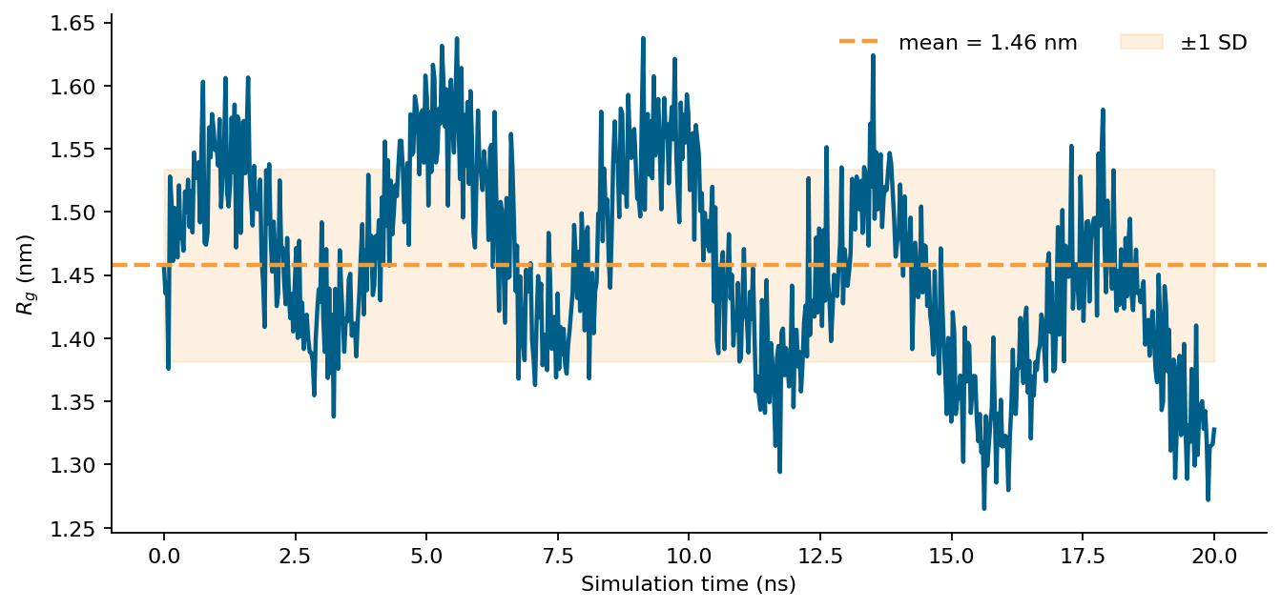
A dynamic descriptor can be more than the mean
• Mean / median
• Standard deviation
• Min / max / range
• Quantiles
• Autocorrelation time
• Transition frequency

Slide 31

4. Polymers: when “the molecule” is an ensemble
When it is too big

Slide 32
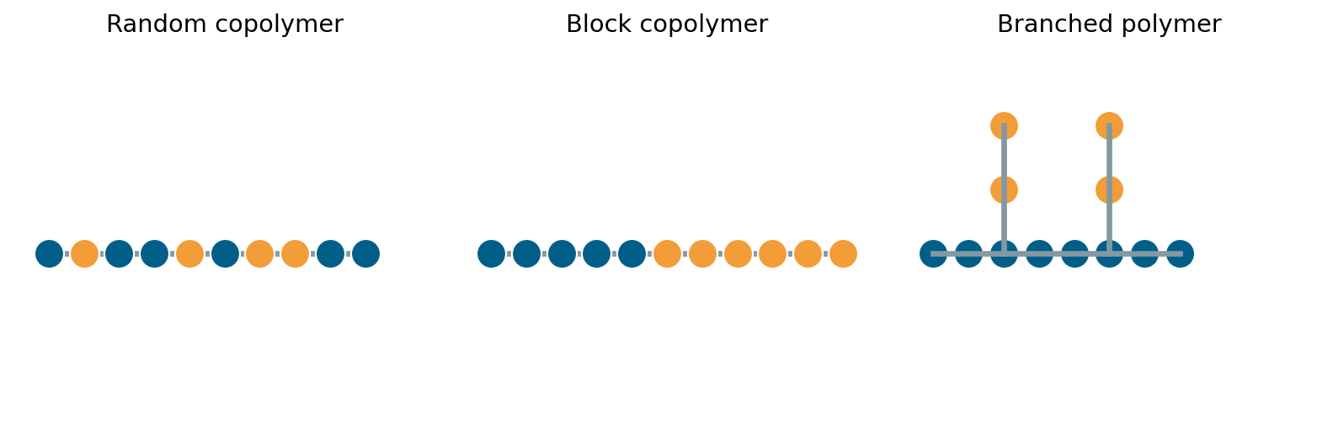
Why ordinary SMILES is awkward for polymers
• No single fixed chain length
• Distributions of molecular weight
• Random vs block sequencing
• Branching and crosslinking
• Tacticity / architecture

Slide 33
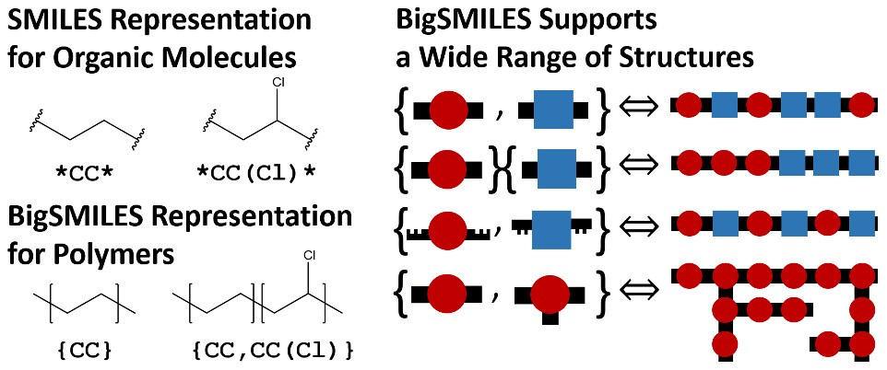
BigSMILES: stochastic objects represent polymer ensembles
• Curly braces denote a stochastic polymeric segment.
• Repeat units are listed inside the stochastic object.
• Bonding descriptors specify permissible connectivity.
• One string represents an ensemble, not one exact graph.
Conceptual example: a stochastic object lists allowed repeat units and how they connect.
Lin et al. ACS Central Science 5, 1523–1531 (2019).

Slide 34
BigSMILES bonding descriptors encode allowed connectivity
[$] … [$]
[>] … [<]
{…}{…}
AA-type: a site can connect to another compatible $ site.
AB-type: > connects to <, preserving directionality of the repeat unit.
Concatenated stochastic objects can encode block architectures.

Slide 35
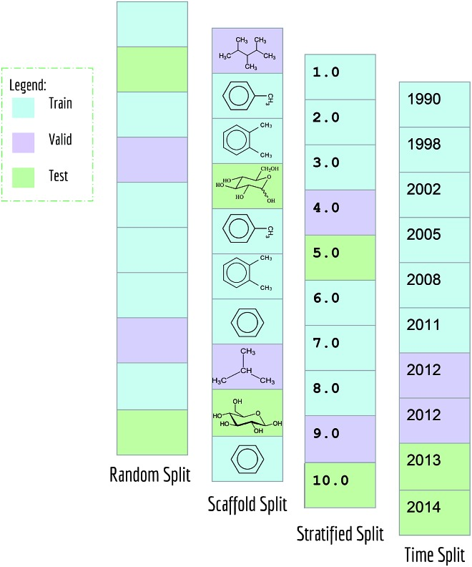
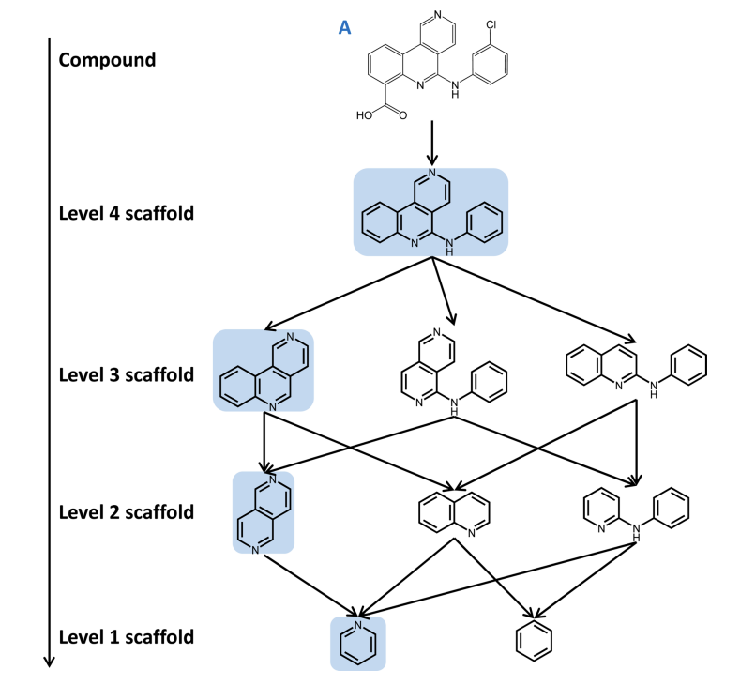
Random split vs scaffold split

Slide 36
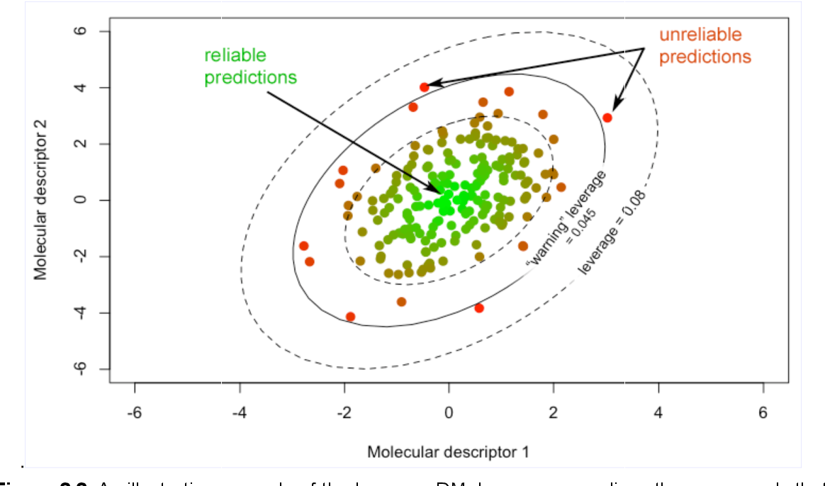
Applicability domain: do we have training chemistry nearby?

Slide 37
Summary table
Representation
What it uses
Strength
Main limitation
Typical model
2D descriptors
graph + rules
interpretable
hand-crafted summary
RF / XGB / SVM
fingerprints
substructures
strong baseline
similarity depends on encoding
RF / XGB / kNN
3D descriptors
coordinates
shape-sensitive
conformer-dependent
MLP / tree models
dynamic / MD
trajectory
captures flexibility
simulation cost / sampling
tree / MLP / sequence
BigSMILES
stochastic polymer syntax
polymer architecture
not one deterministic graph
custom / language / graph

Slide 38

5. PFNs
Wait XGboost is not the best one?

Slide 39
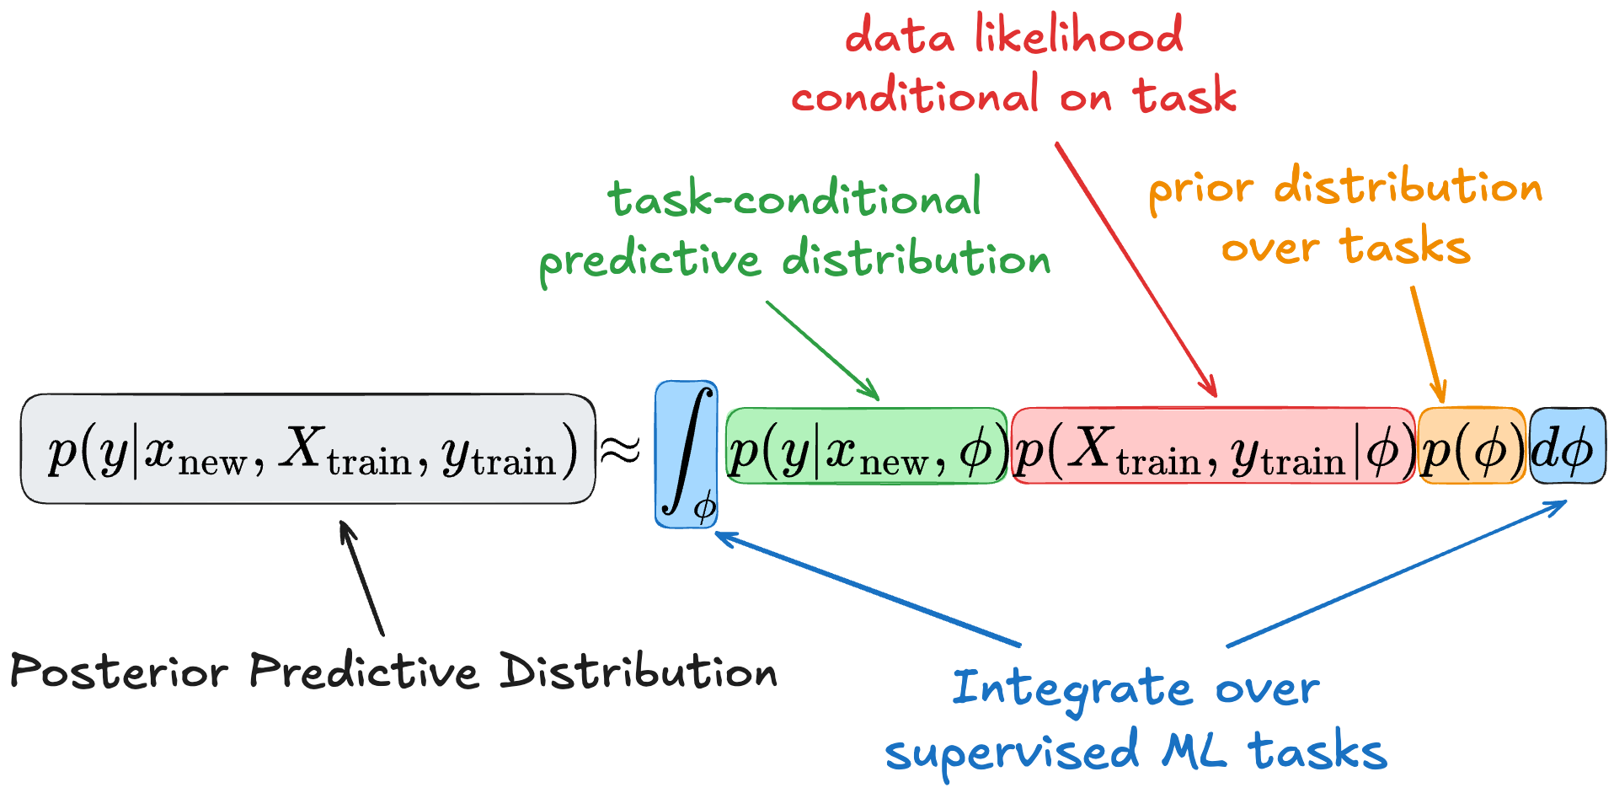
Idea behind PFN

Slide 40
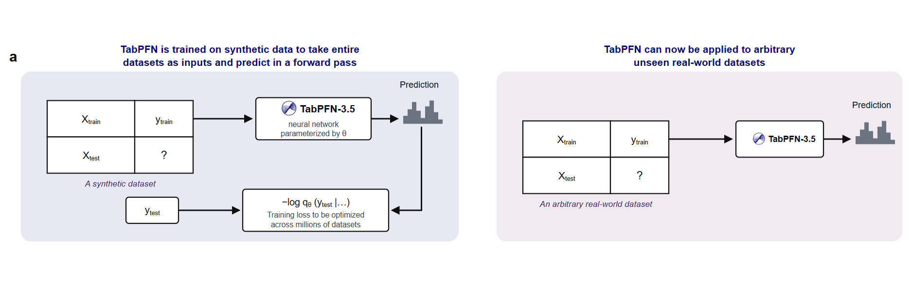
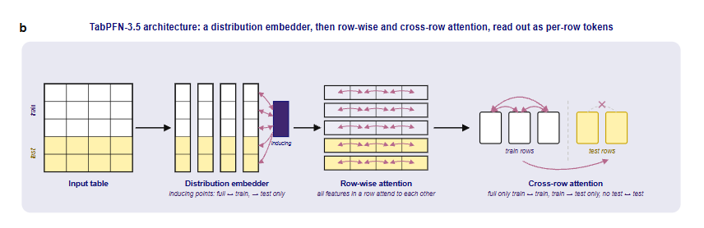
No training

Slide 41
No training

Slide 42
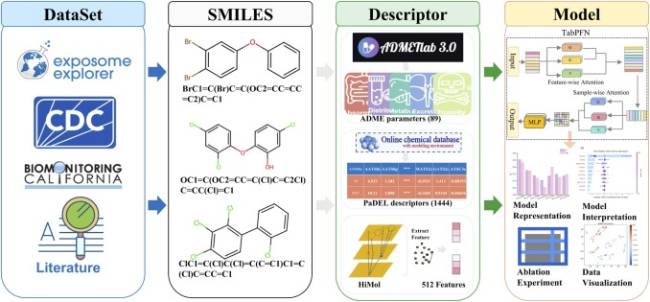
Why it works especially well with QSAR

Slide 43
Why it works especially well with QSAR

Slide 44
Practical
Pull a dataset from Chembl
Prepare and explore it
Extract RDkit features and Fingerprints
Train a model
Compare static and dynamic features
Train GNN model
Competition

